Slide 1
Introduction to Artificial Neural Network:

Slide 2
Introduction to Deep Learning:
Deep learning can be achieved using neural networks and they have been around for quite a long time i.e. around 40-50 years. However, they were not used much in practical applications and did not gain much popularity in early days because training a neural network requires huge datasets and high computing power and they were not available in early days.

Slide 3
What has changed now?
Since the inception of internet, and numerous tasks are being performed on computers, we have huge datasets available to train neural networks.
The processing power of computers has increased substantially along with storage capacity and the hardware has become cheaper. We can buy hardware easily to implement deep learning applications.

Slide 4
Inspiration:
A human brain is the best learning mechanism. Engineers and scientists are trying to mimic human brain behavior to teach computers to learn and to give them the ability to think themselves. Introduction to deep learning involves a lot of similar concepts. Human brain learns when millions and billions of neurons work together. Similarly, deep learning involves a lot of neurons working together.

Slide 5
Applications:
Deep Learning is used in
Artificial neural networks for classification and regression
Convolutional neural networks for computer vision
Recurrent neural networks for time series analysis
Boltzman machines for recommendation systems

Slide 6
Neuron in Deep Learning:
Just like a human brain neuron, neuron in deep learning takes some inputs and generates output. Although the process can be complicated, we will see basic concepts behind it. Let us see a diagrammatic representation.

Slide 7
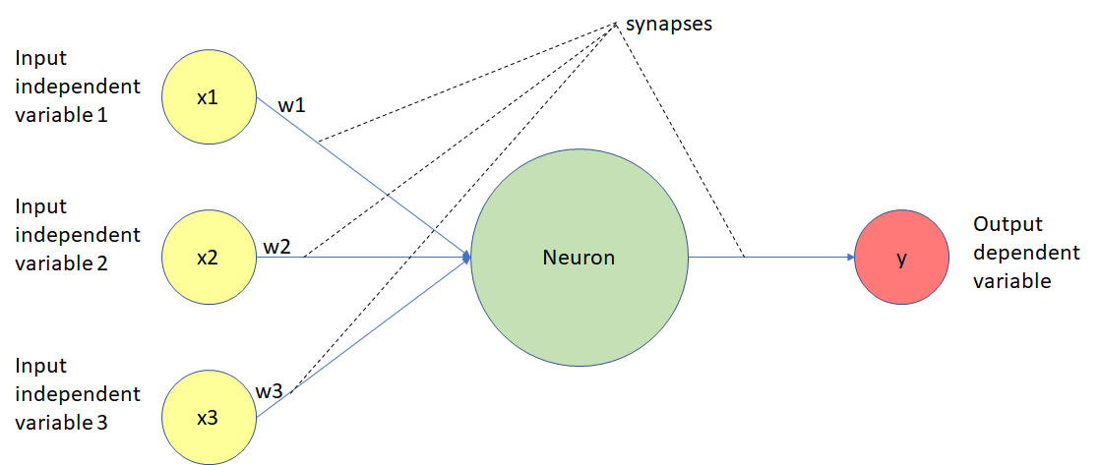

Slide 8
x1, x2 and x3 marked in yellow circles are input variables.
w1, w2 and w3 are associated weights for x1, x2 and x3.
The big green circle is the neuron which performs weighted sum on input values. So, in our scenario the green neuron will perform x1w1 + x2w2 + x3w3. i.e. summation of multiplication of input x and its weight.
After the green neuron performs its calculations, an activation function is applied on the neuron and the output is dependent on it.
y value marked in red circle is output after performing calculations on input variables along with its weights and application of activation function.
All the input or output connects are termed as synapses of neuron in deep learning.

Slide 9
Artificial Neural Networks:
First of all, let us first review our multiple linear regression model. We used it to predict salary of an employee based on hours worked, certifications and years of experience by simply applying a regressor on input variables.

Slide 10
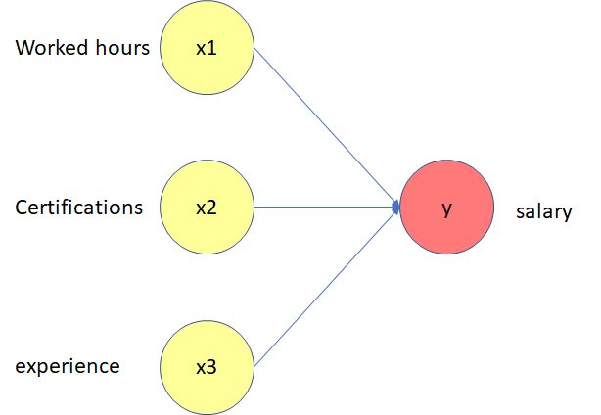
Notes:
We did not involve any intermediate layers between input variables and output variable. However, we can increase accuracy of results by using artificial neural networks.

Slide 11
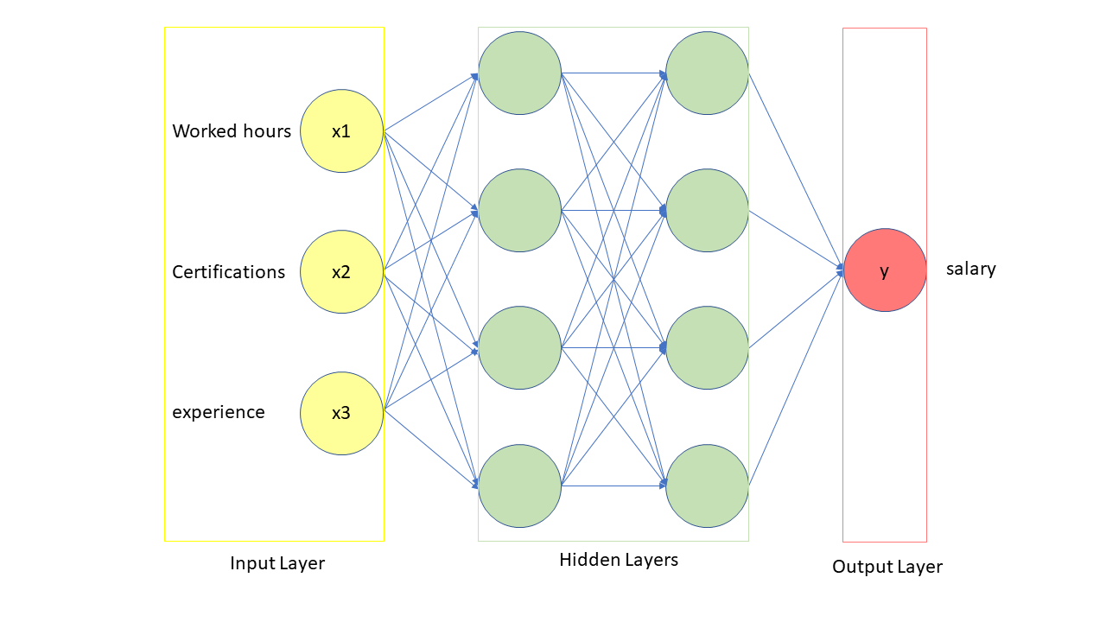

Slide 12
Note that input layer consists of independent variables worked hours, certifications and experience
Now, instead of directly predicting salary, we are feeding input variables to a layer of neurons. They can perform certain operations on input values and pass them on to another layer of neurons.
Second layer of neurons again performs some operations on output values from first layer.
Output from second layer of neurons is passed on as final prediction.

Slide 13
How do Neural Networks Learn? The Neuron:

Slide 14
We have already seen
Each neuron can accept inputs and provide output through synapses.
Each synapse has some weight
Neuron calculates the weighted sum of all inputs and associated weights and then activation function decides its output.

Slide 15
In this process, data is only flowing in forward direction i.e. inputs applied to neuron, neuron performs certain calculation, then activation function triggers the output. However, once output is done, there is no way to improve its accuracy. We can improve it once neural network learns the optimal way for predictions. The question still remains “How do neural networks learn?”.

Slide 16

The Cost Function:
A commonly used cost function is
where
y’ is predicted value for input variables
y is actual value from test dataset
C is the cost function value.

Slide 17
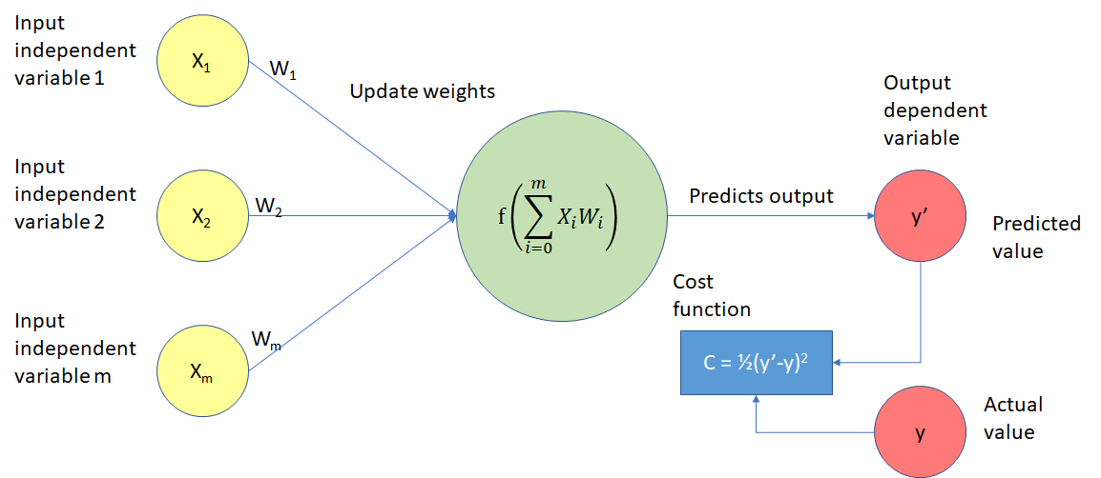

Slide 18
Now, again inputs provided to neuron, it calculates the weighted sum. Activation function is applied to neuron and it predicts output value. This prediction is compared with actual value and cost function is calculated.

Slide 19
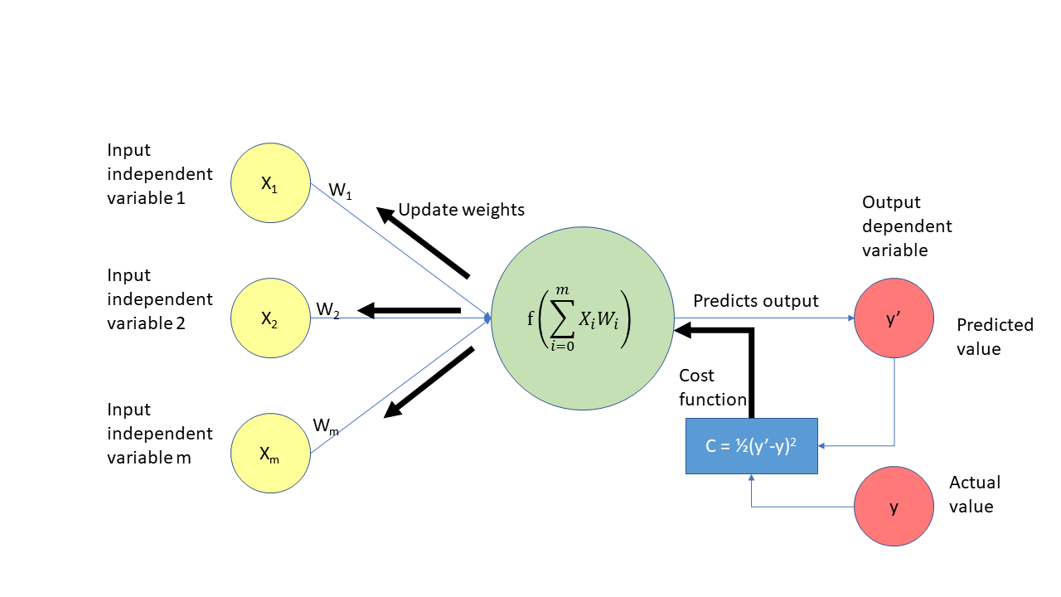
Backpropagation:

Slide 20
Cost function is fed to neuron and weights are adjusted.
Again, neuron calculates weighted sum with updated weights.
Activation function is applied to neuron and it makes another prediction for same data points.
Then again, cost function is calculated from new prediction and actual value and it is fed back to neuron.
The process goes on until optimum cost function i.e. having value closest to zero is obtained.
A whole neural network can learn just like a neuron learns. It decides optimum cost function based on gradient descent or stochastic gradient descent.

Slide 21
ANN
The Problem Statement:
We have a dataset of customers of a bank. It consists of customerId, surname, creditScore, geography, gender,age, tenure, balance, numberOfProducts, hasCreditCard, isActiveMember, estimatedSalary and whether is exited the bank. Based on the data we want to predict whether a customer is going to leave the bank or not. This is a classification problem.

Slide 22

Read dataset:

Slide 23
Note that we are picking only relevant independent variables from dataset and storing in X matrix. We omitted columns 0,1 and 2 from dataset as rowNumber, customerId and surname are not really important for deciding whether the customer will leave the bank or not.
y matrix stores whether customer left the bank or not.
Data Preprocessing:
Note that customer information contains categorical variables gender and geography. We need to encode them and convert into.

Slide 24
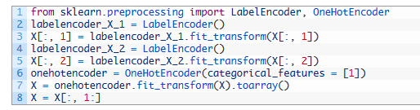

Slide 25
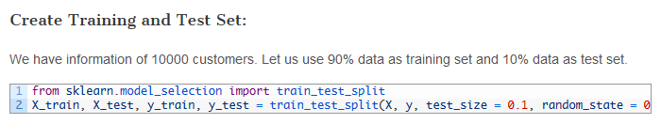

Slide 26
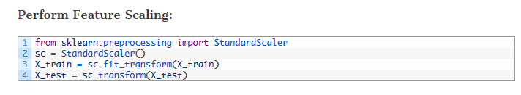

Slide 27
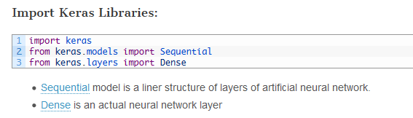
Artificial Neural Network Using Keras:

Slide 28
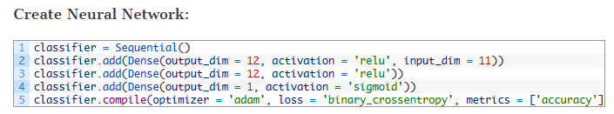

Slide 29
We initialized an artificial neural network using keras Sequential class and stored in classifier. Then created a Dense input layer with output_dim as 11 ( The number 11 came from simply adding 10 input variables and 1 output variable. There is not strict rule for output_dim parameter ),
activation function as ‘relu’ (It is actually a rectifier function and generally applied to input and hidden network layers ) and
input_dim = 10 because we have 10 independent input variables in X matrix.
added this layer to neural network using classifier.add()

Slide 30
Then created another Dense hidden layer with similar parameters without input_dim (because input_dim parameter is provided to only input layer) and added this hidden layer using classifier.add() Then created an output layer with output_dim as 1 and sigmoid activation function (because generally it is applied for output layers) and added it to network by classifier.add(). Then compiled this neural network using ‘adam’ optimizer, ‘binary_crossentropy’ loss function for accuracy metrics

Slide 31
That’s it. We have created a neural network, added an input layer, a hidden layer and an output layer to it and compiled it. Now its time for training and making predictions.

Slide 32
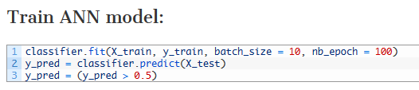
classifier.fit() method trains the model with 9000 rows in batch size of 10 rows each. Once the model is trained with all 9000 rows, one epoch is completed. As we have provided nb_epoch = 100 . Our model will be trained 100 times in batches of 10 rows on 9000 rows. As explained in previous articles, different weights will be assigned to neural networks using backpropagation so that optimal cost function value is found.

Slide 33
Note that our model calculates probability of a customer leaving bank. We are deciding a customer will leave bank if probability is more than 0.5 or he stays with bank if probability is less than or equal to 0.5.

Slide 34
